Slide 1

Lending Club
Exploratory Data Analysis

Slide 2
Problem Statement
To analyse the available data past loan applicants and whether they ‘defaulted’ or not. The aim is to identify patterns which indicate if a person is likely to default
For the purposes of this analysis, the customers labelled as 'charged-off' are the 'defaulters’
It is assumed that we are looking for the probability of default at the time the loan is approved and will ignore current loans.
Only data that was available at the time the loan was funded will be utilized.

Slide 3
Approach
Import data and cleanse
Derived Metrics
Univariate continuous analysis
  Continuous
  Segmented
Univariate segmented analysis
  Continuous
  Segmented
Bivariate Analysis

Slide 4
Import data and cleanse
Data was imported from the file supplied by the lending club
The data was then cleansed
  Checked for duplicates but none were found
  Deleted unnecessary columns
    empty columns
    single value columns
    Columns populated after the loan was issued
  Deleted unnecessary rows
  Fixed missing values
  Fixed incorrect data types

Slide 5
Derived Metrics
Used the Addr_State field to obtain:
  full state name
  Division
  Region
A column was calculated to indicate the percentage of the requested amount that was funded
A column was calculated to indicate if it appeared the loan amount had been rounded to the nearest $5k
Date columns where split in to component parts (year, quarter, month)
A column was added to signify if the loan had defaulted or not

Slide 6
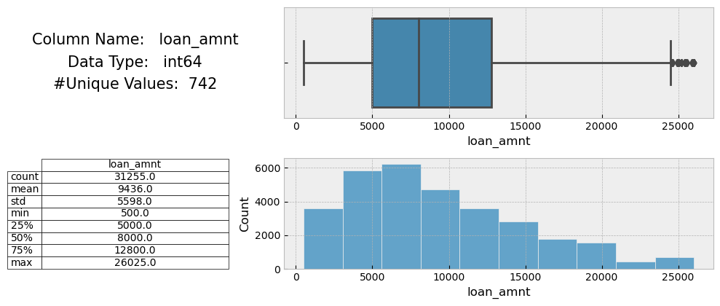
Univariate continuous analysis
All continuous rows were analysed to help understand the data
This identified many loans with figures higher than would be expected
It also identified date columns with incorrect future values

Slide 7
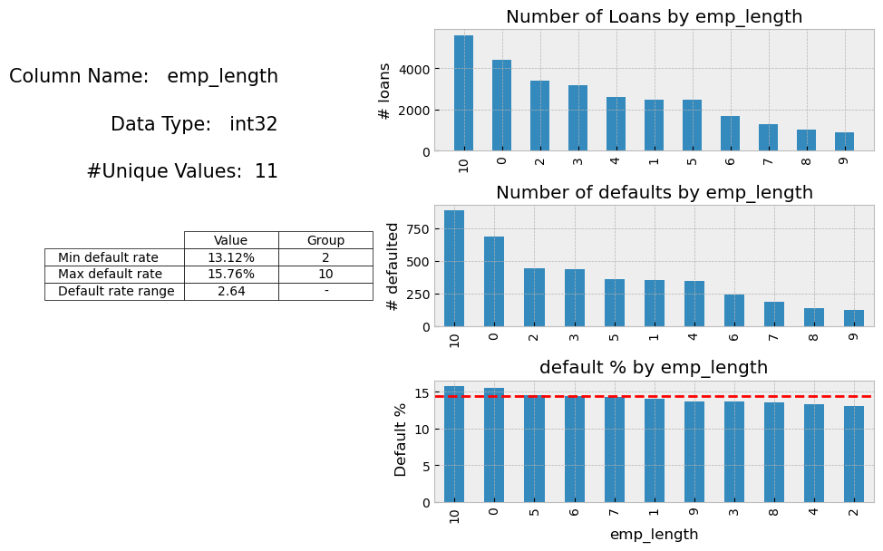
Segmented Univariate Analysis
All segmented rows were analysed to help understand the data
This identified the % of loans that defaulted per value
If there is a big variation in the default rate, then the column may be a good indicator or risk.

Slide 8
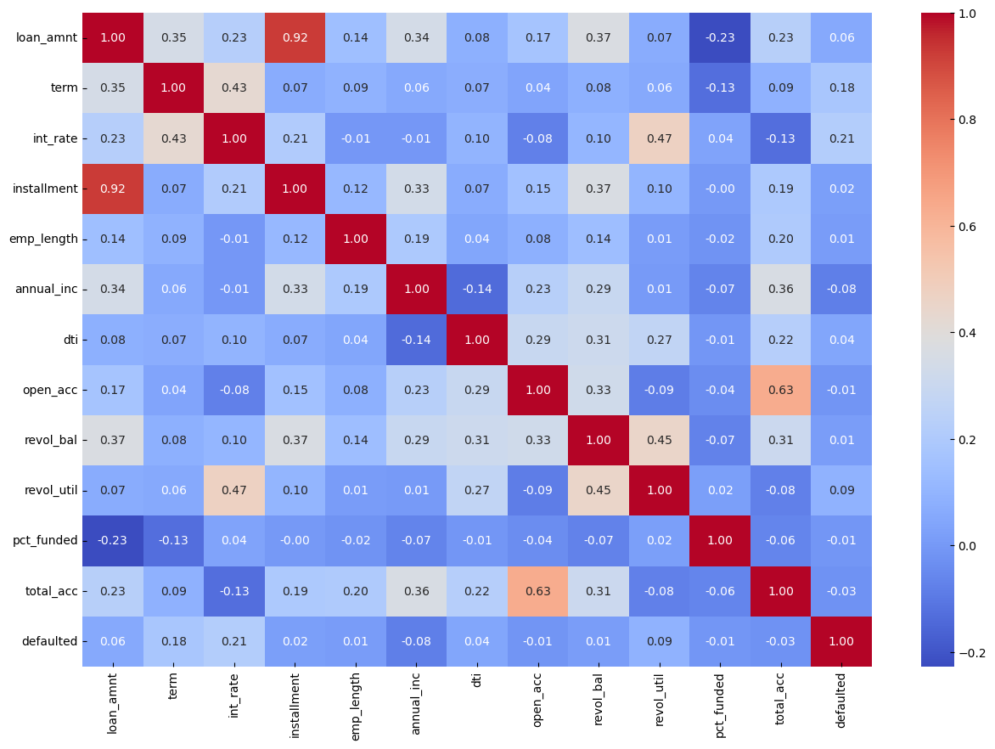
Bivariate Analysis on continuous data
Looked for correlations between continuous values
No strong correlations were found to the default rate
Weak correlations were found between the default rate and:
    Term
    Interest rate
    Revolving credit balance

Slide 9
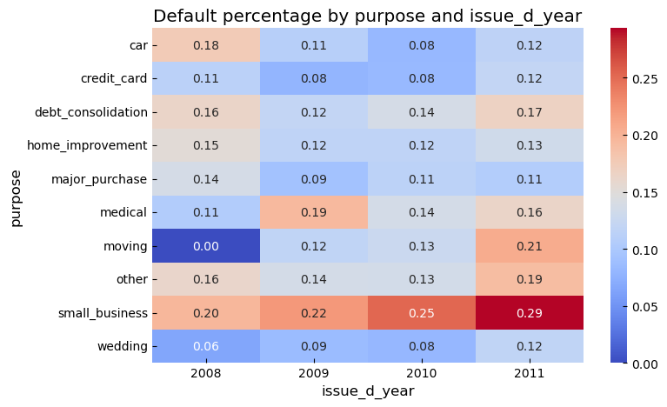
Bivariate Analysis on Segmented Data
Looked for correlations between segmented values
This was a richer source of insight
We found many interesting combinations of values
For example, the default rate of small business loans has increased each year

Slide 10
Findings
Whilst the data contained a lot of errors and redundant data, it also held a lot of insight. More than I could extract in the time period provided.
Key findings are now provided in the following slides.
  These findings are based on the cleansed data.
  It is assumed the cleansed dataset is representative of the wider dataset
  Any figures quoted may not match the complete dataset

Slide 11
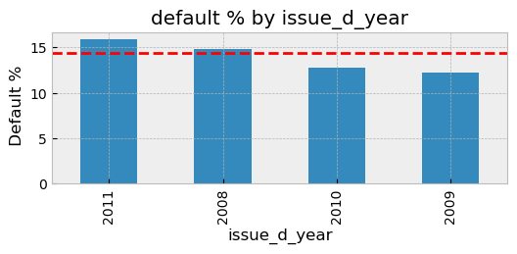
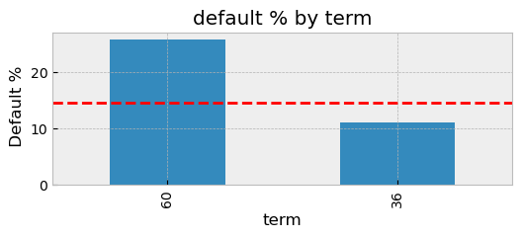
Default Rates
The percentage of loans defaulting is increasing each year
The percentage of loans defaulting is higher for loans with longer terms
In all slides the red dashed line indicates the average default rate across the whole dataset

Slide 12
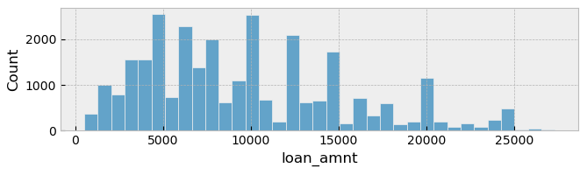
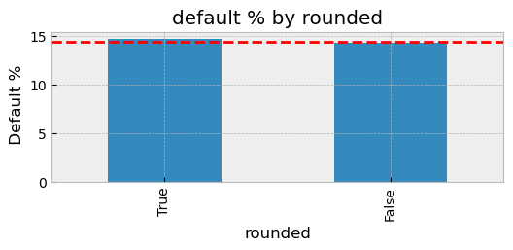
Loan Rounding
Looking at the distribution of loan amounts it would appear that there is a tendency to round loans to the nearest $5K
There is no indication that this rounding has a major impact on the probability of defaulting.

Slide 13
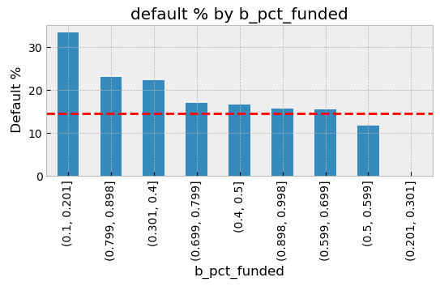
Loans not fully funded
Loans that are not fully funded have a higher default rate than those that are.
For example, applicants that receive only 10-20% of the loan requested have >30% default rate.

Slide 14
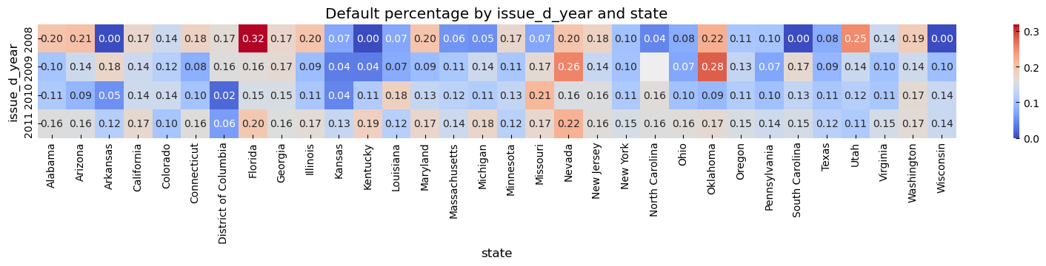
Geographical factors
Risk of default varies by state and over time. Looking at current default rate and historic trends you can assess the risk of the states.
Risky states: Nevada, Florida, Kentucky, Michigan, Maryland
Safer states: Louisiana, Minnesota, Utah, Colorado

Slide 15
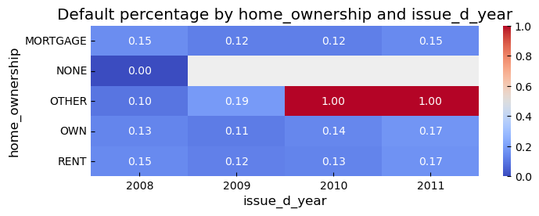
“Other” Home Ownership
While the volume of loans with the home ownership classified as other is small, they appear to be high risk.
All loans issued in 2010 and 2011 with this classification defaulted

Slide 16
Small business loans and moving
Loans for small businesses and moving are getting riskier
The default rate for these loans has increased year on year.

Slide 17
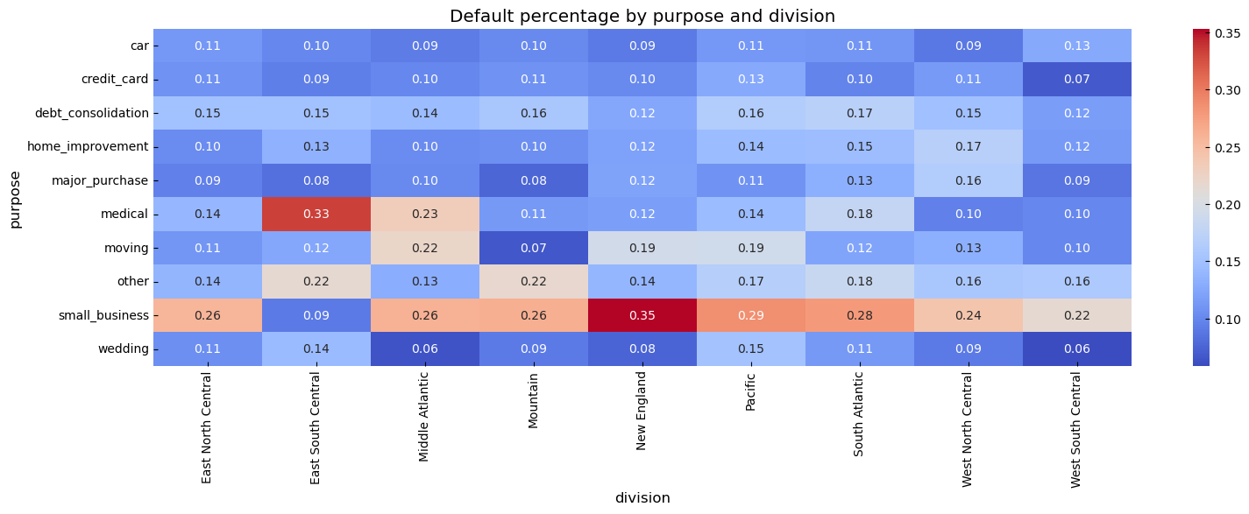
Small business loans and moving
Loans for small businesses appear to carry different risks in different divisions but “moving” loans are not impacted.
Business loans in New England are most likely to default where as East South Central are the least.

Slide 18
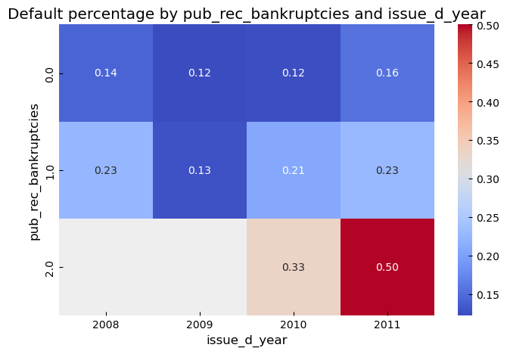
Bankruptcies
As you would expect the number of bankruptcies recorded is an indicator of the risk of default.
The impact of this figure appears to be increasing year on year.

Slide 19
Concerns
Looking at the data there are many questions regarding causality that I have not been able to address. For example:
Are people more likely to default if they have a high interest rate or have a high interest rate because they were likely to default?
Does not fully funding a loan increase the risk of default, or was the loan not fully funded because other factors indicated the risk was high?

